Slide 1

South African Renal Registry
Data as at 31 December 2015

Slide 2
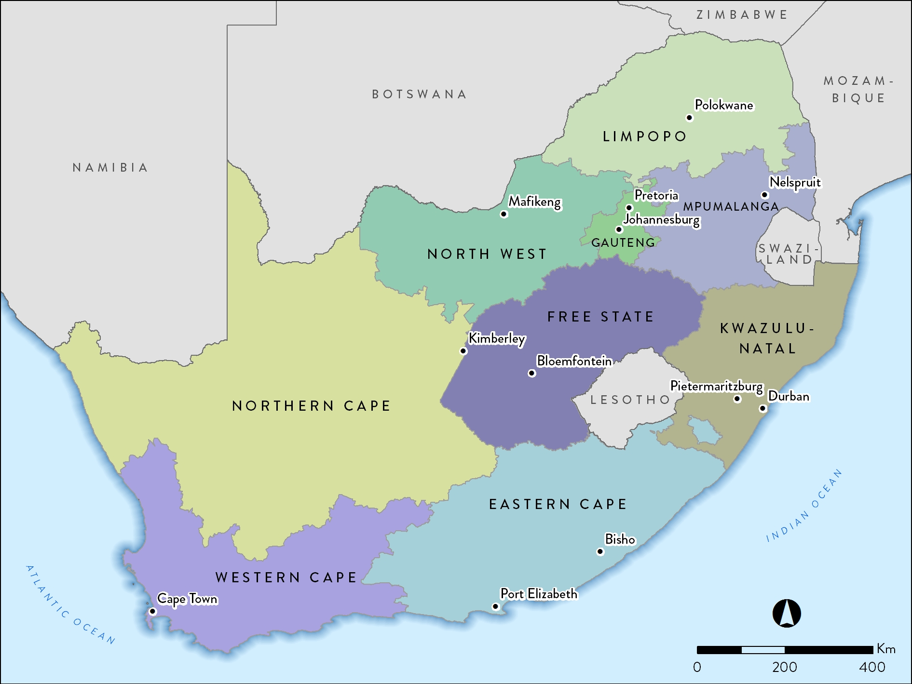
54.96 million

Slide 3
Population data for 2015
Population group | million | %
Black | 44.23 | 80.5
Coloured | 4.83 | 8.8
Indian/Asian | 1.36 | 2.5
White | 4.53 | 8.3
Total | 54.96 | 100.0
Stats SA: 2015 mid-year estimates
Notes:
African 44 227 995 Coloured 4 832 916 Indian/Asian 1 362 002 White 4 534 008 Grand Total 54 956 920

Slide 4
Population data by province
 | million | %
Eastern Cape | 6.92 | 12.6
Free State | 2.82 | 5.1
Gauteng | 13.20 | 24.0
KwaZulu-Natal | 10.92 | 19.9
Limpopo | 5.73 | 10.4
Mpumalanga | 4.28 | 7.8
North West | 3.71 | 6.7
Northern Cape | 1.19 | 2.2
Western Cape | 6.20 | 11.3
Total | 54.96 | 100.0
Stats SA: 2015 mid-year estimates

Slide 5
Treatment centres reporting data
 | 2015 | %
Public sector | 30 | 11.6
Private sector | 228 | 88.4
Total | 258 | 100.0

Slide 6
Centres by province and sector
 | EC | FS | GT | KZ | LP* | MP | NW | NC | WC | ALL
Public | 3 | 6 | 7 | 5 | 0 | 0 | 3 | 1 | 5 | 30
Private | 19 | 11 | 69 | 58 | 11 | 10 | 14 | 4 | 32 | 228
Total | 22 | 17 | 76 | 63 | 11 | 10 | 17 | 5 | 37 | 258
* One privately-owned unit in Limpopo operates as a public-private partnership on the premises of a public hospital and serves mainly state patients.

Slide 7
How many patients do we treat?
10360

Slide 8
Prevalence of patients on RRT
 | 2015
Population in millions | 54.96
ESRD patients on treatment | 10360
Treatment rate in pmp | 189

Slide 9
Patients on RRT by province
 | EC | FS | GT | KZ | LP | MP | NW | NC | WC | ALL
Total | 1040 | 544 | 3238 | 2286 | 337 | 273 | 466 | 148 | 2028 | 10360

Slide 10
RRT by province (pmp)

Slide 11
Prevalence by sector
 | Public | Private
Population in millions | 46.15 | 8.81*
ESRD patients on treatment | 3318 | 7042
Treatment rate (pmp) | 71.9 | 799.3
* Council for Medical Schemes Annual Report 2015/16

Slide 12
Patients by province and sector
 | EC | FS | GT | KZ | LP | MP | NW | NC | WC | ALL
Public | 315 | 227 | 958 | 630 | 72 | 17 | 161 | 82 | 856 | 3318
Private | 725 | 317 | 2280 | 1656 | 265 | 256 | 305 | 66 | 1172 | 7042
Total | 1040 | 544 | 3238 | 2286 | 337 | 273 | 466 | 148 | 2028 | 10360

Slide 13
RRT by province and sector (pmp)
Notes:
Adjusted for unclassified medical aid beneficiaries

Slide 14
Treatment modality
Modality | Patients | %
Haemodialysis | 7529 | 72.7
Peritoneal dialysis | 1440 | 13.9
Transplant | 1391 | 13.4

Slide 15
Modality by sector
Public
Private
Treatment modality | Public sector |  | Private sector
 | Patients | % | Patients | %
Haemodialysis | 1517 | 45.7 | 6012 | 85.4
Peritoneal dialysis | 963 | 29.0 | 477 | 6.8
Transplant | 838 | 25.3 | 553 | 7.9

Slide 16
New kidney transplants in 2015
 | Deceased donor |  | Living related |  | Living unrelated |  | Total
 | C | A | C | A | C | A
Western Cape - Public | 8 | 34 | 3 | 6 | 0 | 9 | 60
Western Cape - Private | 0 | 19 | 0 | 21 | 0 | 16 | 56
Gauteng - Public | 2 | 32 | 0 | 1 | 0 | 0 | 35
Gauteng - Private | 5* | 45* | 1 | 11 | 0 | 14 | 76
KwaZulu-Natal - Public | 0 | 0 | 0 | 0 | 0 | 0 | 0
KwaZulu-Natal - Private | 0 | 9 | 0 | 9 | 0 | 5 | 23
Free State - Public | 0 | 0 | 0 | 0 | 0 | 0 | 0
Free State - Private | 0 | 4 | 0 | 0 | 0 | 0 | 4
Total | 15 | 143 | 4 | 48 | 0 | 44 | 254
C = child recipient <18 years; A= adult recipient 18 years and older
*Includes 2 child and 1 adult kidney-liver transplants, and 3 adult kidney-pancreas transplants
The kidney transplant rate for 2015 (population 54.96 million) was 4.6 pmp
Data supplied by the SA Organ Donor Foundation.

Slide 17
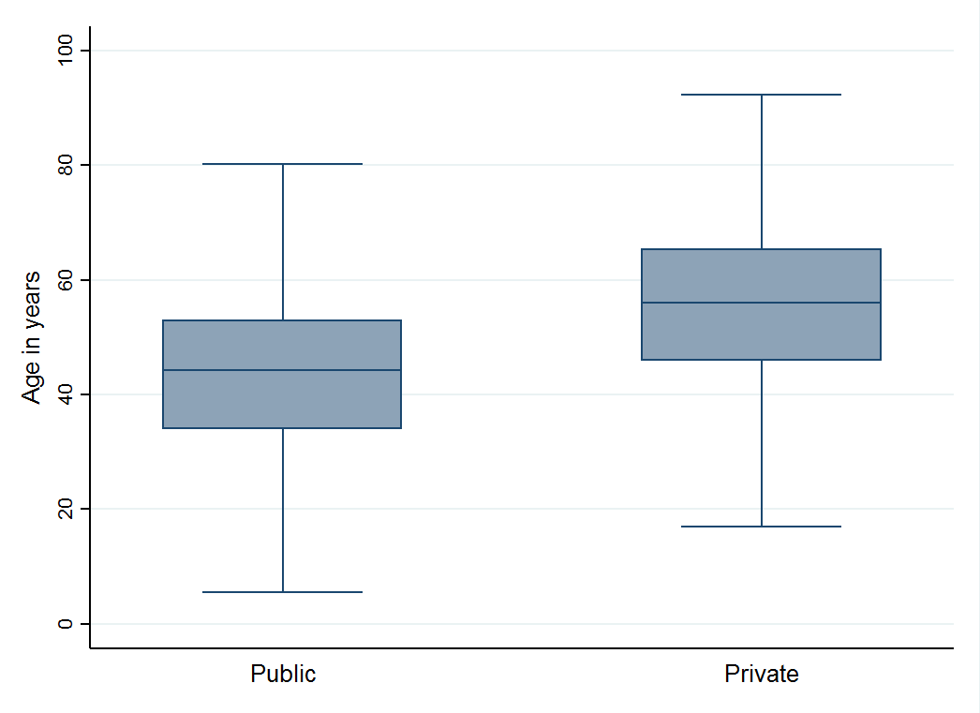
Age by sector
Mean age of all patients: 51.3 ± 15.0 years
43.4 ± 13.5 years
55.0 ± 14.3 years

Slide 18
Gender distribution

Slide 19
Distribution by ethnicity (%)
Data on ethnicity available for 10077 patients

Slide 20
Prevalence of patients on RRT by ethnicity (pmp)
Data on ethnicity available for 10077 patients

Slide 21
Common causes of ESRD
 | % of total
Uncertain or not stated | 34.1
Hypertensive renal disease | 33.7
Diabetic nephropathy | 14.4
Glomerular disease | 9.5
Cystic kidney disease | 2.9
Obstruction and reflux | 1.5
Notes:
GN = 3235
HT = 3104
DM = 1273
CYSTIC = 282
UNKNOWN = 1228
OTHER = 331
Genitourinary causes = 138
Total = 9591

Slide 22
Patients on RRT with diabetes
 | Diabetics | % of total
Public (n = 2631) | 1005 | 38.2
Private (n = 5371) | 3113 | 58.0
All (n= 8002) | 4118 | 51.6
No. of patients with data on diabetes = 8002

Slide 23
Hepatitis B status
No. of patients with data = 7056

Slide 24
Hepatitis C status
No. of patients with data = 6178

Slide 25
HIV status
No. of patients with data = 6464

