Slide 1
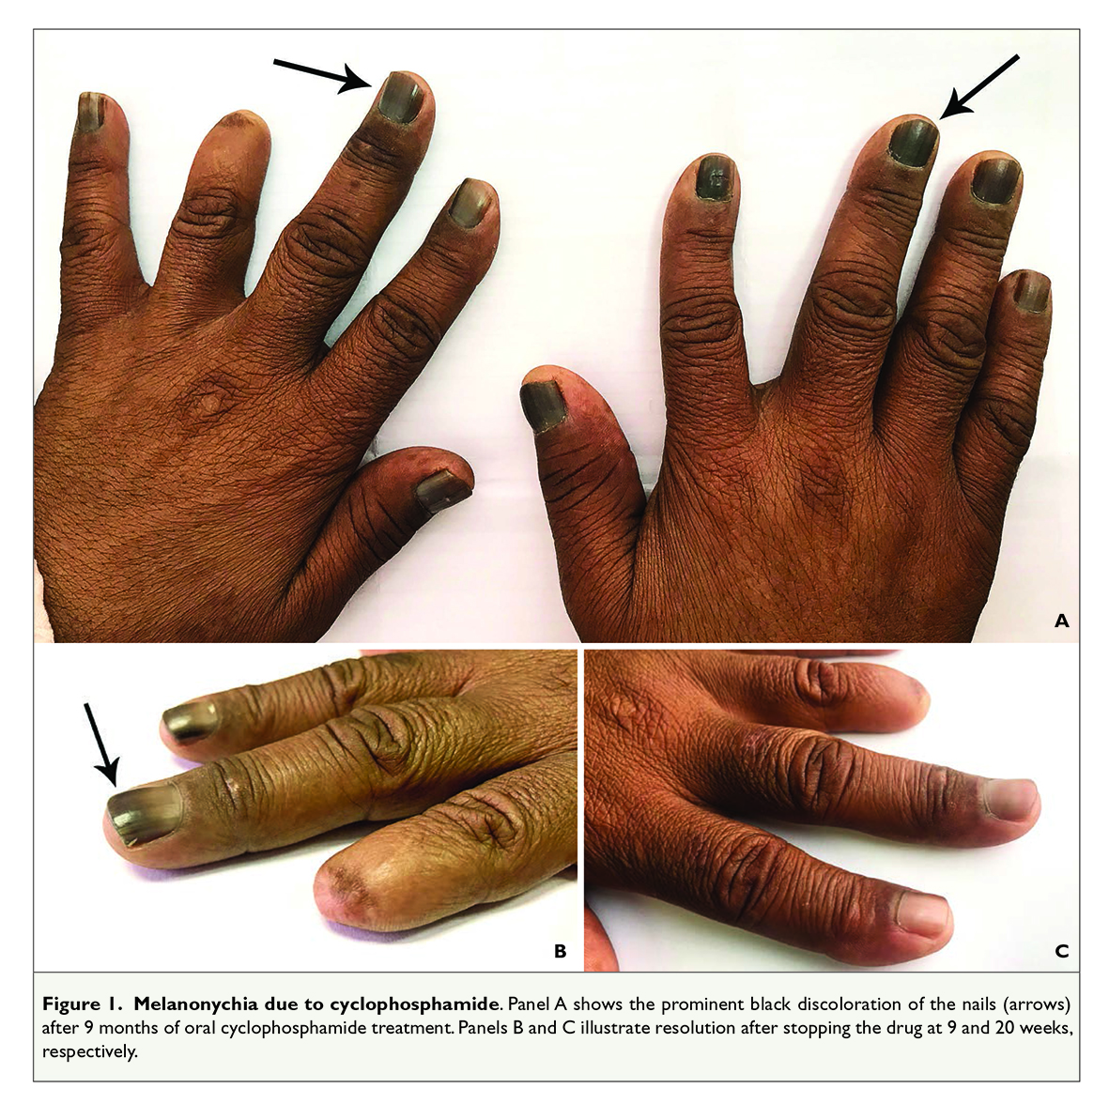
Melanonychia due to cyclophosphamide
Amirali, Afr J Nephrol, 2019

