Slide 1
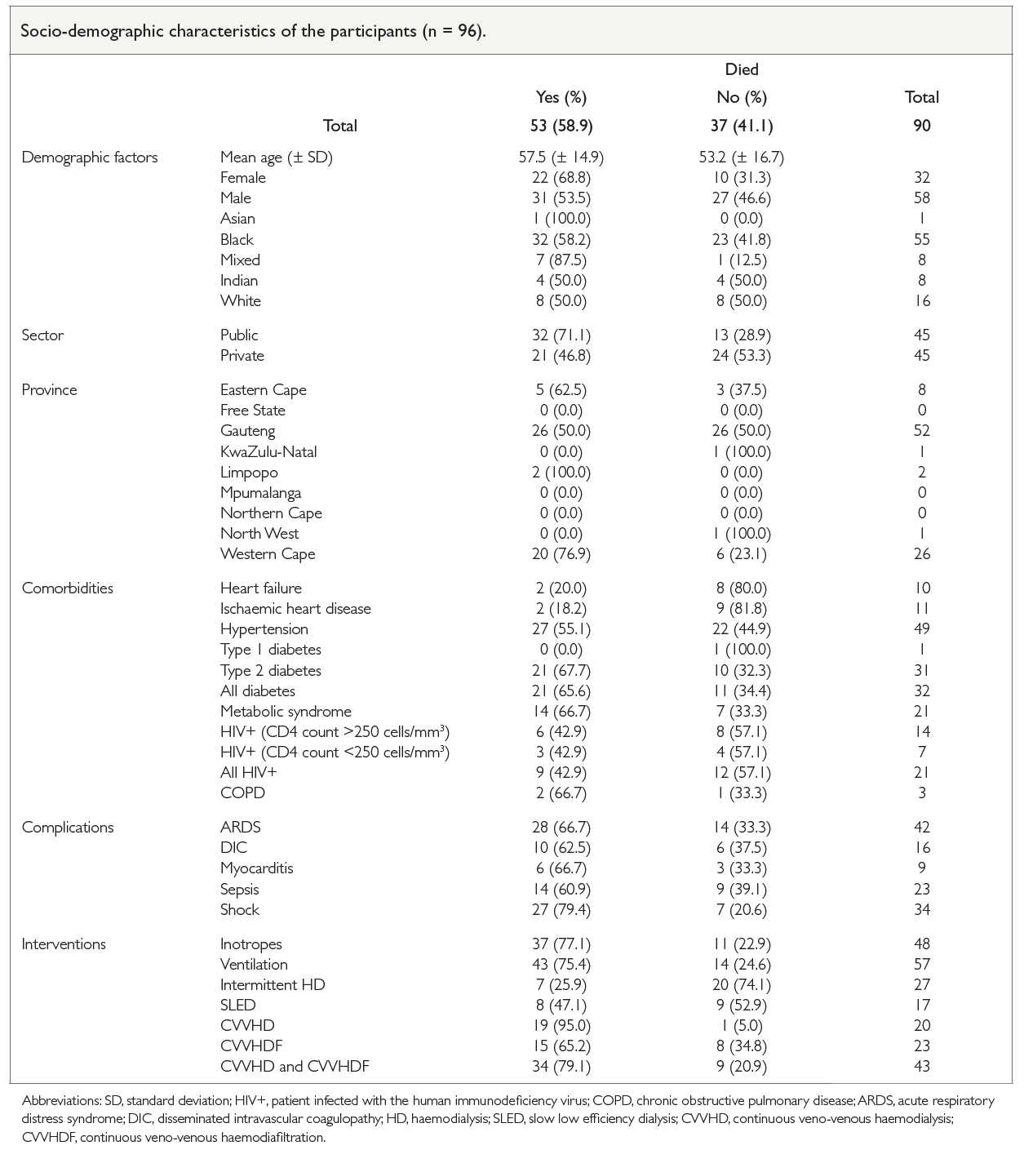
COVID-19-related acute kidney injury and dialysis: What are the outcomes in South Africa?
Wesley van Hougenhouck-Tulleken, Muhammed Hussain, Claudia do Vale
Background The higher mortality in hospitalized patients with acute kidney injury infected with COVID-19 is well documented in developed countries. This study aimed to document the mortality in COVID-19-infected South African patients who required dialysis for AKI. Exclusion criteria included any chronic kidney replacement therapy.
admission to a private healthcare facility were associated with lower mortality. No associations were found with ethnicity, sex, hyper-tension, diabetes, HIV infection or the use of other modes of dialysis.
Methods A REDCap survey of South African nephrologists and nephrology fellows registered with the South African Nephrology Society was conducted. The primary outcome was all-cause in-hospital mortality, while additional points of interest included comorbidities, dialysis modality and intervention required. Univariate analysis of mortality predictors was performed.
Results The COVID-19-related AKI mortality rate was 58.9%. Significant predictors included continuous veno-venous haemodialysis therapy, invasive ventilation, use of inotropes and the presence of shock. Ischaemic heart disease, heart failure, and
Conclusion In South African patients, we report similar outcomes in critically ill patients requiring dialysis for AKI, relative to international data. The predictors of mortality most likely reflect the severity of the illness in our patients.
Afr J Nephrol. 2021; 24 (1): 46-50
DOI: https://doi.org/10.21804/24-1-4577

