Slide 1
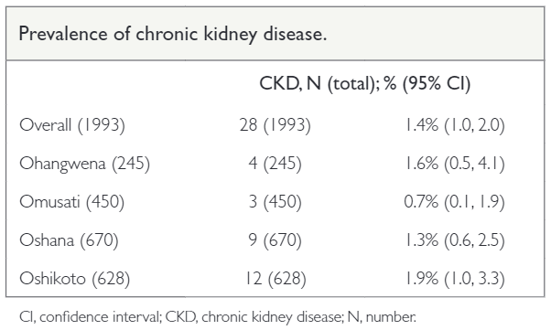
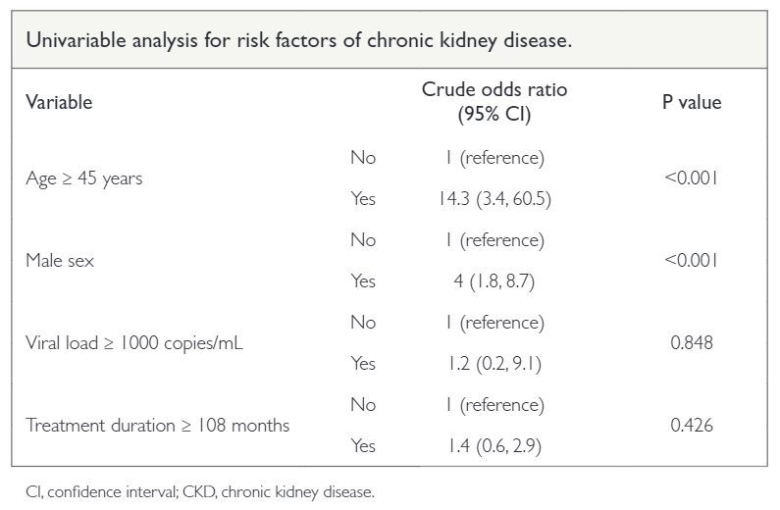
Prevalence of chronic kidney disease among HIV-infected adults on antiretroviral therapy in northern Namibia: a cross-sectional study
Michael Mboko, Tonya Marianne Esterhuizen, Mogamat Razeen Davids
Background This study, we aimed to estimate the prevalence of chronic kidney disease (CKD) and associated factors in HIV-infected adults on antiretroviral therapy in northern Namibia.
duration on antiretroviral therapy was 107 months (IQR 62–149).
Methods A cross-sectional study in the four regions of northern Namibia, using existing electronic records used in the management of HIV-infected patients. Variables captured included the two most recent serum creatinine measurements, date of birth, sex, date of initiating antiretroviral therapy, current antiretroviral treatment, and most recent HIV viral load results. CKD was defined as estimated GFR (eGFR) < 60 mL/min/1.73 m2 on two occasions at least three months apart, using standardized creatinine and the CKD-EPI equation. Factors associated with CKD were assessed using logistic regression.
Results We included 1 993 participants, of whom 1 362 (68%) were female and mean age was 44.5 ± 11.5 years. The proportion of participants who were virally suppressed was 97% (95% CI 96, 98%) and the median
Conclusion Our findings suggest a low prevalence of CKD among the HIV-infected population in northern Namibia. Patients older than 45 years may need additional monitoring.
Afr J Nephrol. 2021; 24 (1): 39-45
DOI: https://doi.org/10.21804/24-1-4702

