Slide 1
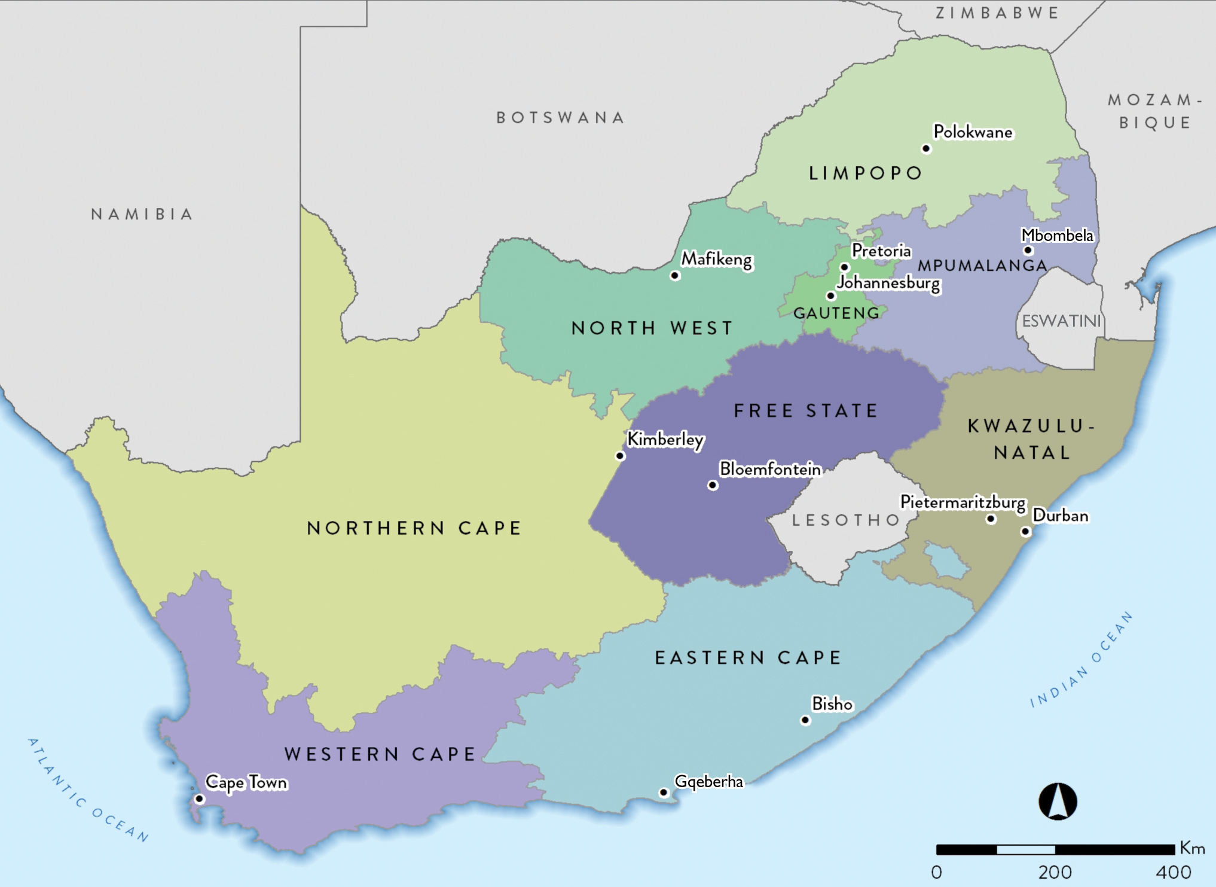
59.62 million

Slide 2
Population data by ethnic group
Population group | Million | %
Black | 48.15 | 80.8
Coloured (mixed ancestry) | 5.25 | 8.8
White | 4.68 | 7.8
Indian/Asian | 1.54 | 2.6
Total | 59.62 | 100

Slide 3
Population data by province
Province | Million | %
Eastern Cape | 6.73 | 11.3
Free State | 2.93 | 4.9
Gauteng | 15.49 | 26.0
KwaZulu-Natal | 11.53 | 19.3
Limpopo | 5.85 | 9.8
Mpumalanga | 4.68 | 7.8
North West | 4.11 | 6.9
Northern Cape | 1.29 | 2.2
Western Cape | 7.01 | 11.8
Total | 59.62 | 100

Slide 4
Number of treatment centres by province and sector
Sector | EC | FS | GT | KZ | LP | MP | NW | NC | WC | All
Public | 4 | 7 | 7 | 6 | 1 | 0 | 3 | 1 | 5 | 34
Private | 23 | 14 | 79 | 62 | 15 | 15 | 13 | 5 | 36 | 262
Total | 27 | 21 | 86 | 74 | 16 | 15 | 15 | 6 | 39 | 296

Slide 5
Prevalence (pmp) and numbers of patients on KRT by province
Province | EC | FS | GT | KZ | LP | MP | NW | NC | WC | All
Patients | 1056 | 552 | 2552 | 1701 | 318 | 240 | 293 | 145 | 1877 | 8734

Slide 6
KRT prevalence (pmp) by healthcare sector
 | Public | Private
Population in millions | 50.72 | 8.90*
Patients on treatment | 2 248 | 6 486
Treatment rate (pmp) | 44 | 729
* Council for Medical Schemes Annual Report 2020/21

Slide 7
Numbers of patients by province and sector
Sector | EC | FS | GT | KZ | LP | MP | NW | NC | WC | All
Public | 286 | 263 | 399 | 247 | 75 | 12 | 53 | 70 | 843 | 2 248
Private | 770 | 289 | 2153 | 1454 | 243 | 228 | 240 | 75 | 1034 | 6 486
Total | 1056 | 552 | 2552 | 1701 | 318 | 240 | 293 | 145 | 1877 | 8 734

Slide 8
KRT prevalence (pmp) by province and sector
Notes:
Adjusted for unclassified medical aid beneficiaries

Slide 9
Distribution of patients by treatment modality
Modality | Patients | %
Haemodialysis | 6 134 | 70.2
Peritoneal dialysis | 795 | 9.1
Transplant | 1 805 | 20.7

Slide 10
KRT modality by sector
Public
12.8%
Private
4.4%
43.3%
33.9%
82.8%
22.8%
Treatment modality | Public sector |  | Private sector
 | Patients | % | Patients | %
Haemodialysis | 762 | 33.9 | 5 372 | 82.8
Peritoneal dialysis | 513 | 22.8 | 282 | 4.4
Transplant | 973 | 43.3 | 832 | 12.8

Slide 11
KRT patient numbers and prevalence by ethnicity
Prevalence per million population

Slide 12
Most commonly reported causes of kidney failure
 | % of total
Hypertensive kidney disease | 36.6
Cause unknown | 30.4
Diabetic nephropathy | 14.3
Glomerular disease | 11.0
Cystic kidney disease | 3.3
Obstruction and reflux | 1.7

